Slide 1

Net Core 3.1 Anses – Día 1
Robert Rozas Navarro
Customer Engineer
Azure-App Dev Domain

Slide 2



ASP.NET Core
Open-source
Cross-platform
Blazingly fast!

Slide 3

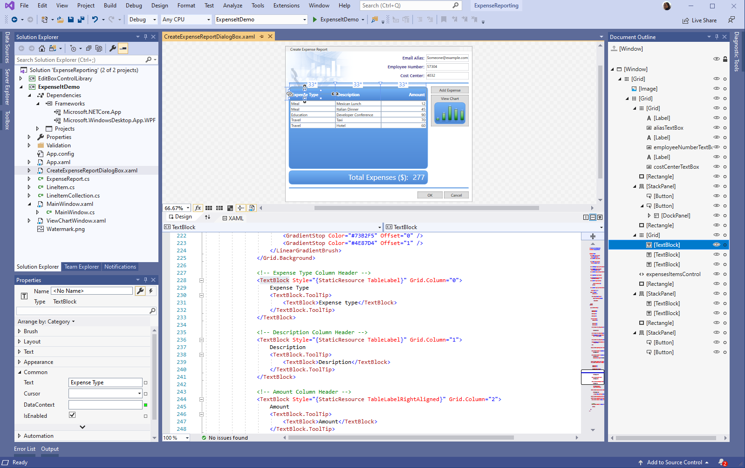
RELEASED
.NET Core 3.x
WPF and Windows Forms support
Side-by-side support & self-contained EXEs
Full-stack web development with C# and Razor
New C# 8.0 language features
dot.net/get-core3

Slide 4
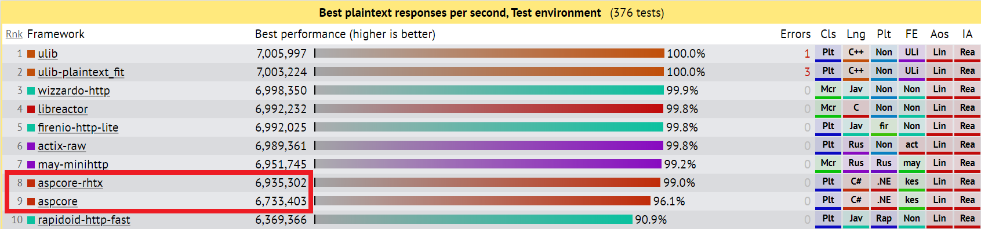
ASP.NET Core performance
Top 10 on TechEmpower

Slide 5
ASP.NET Core performance improvements
Plaintext (MW)
JSON (MW)
JSON (MVC)
Fortunes (MW)
2.2
2.6M RPS
600 ms TTFR
1,060 MB
522K RPS
718 ms TTFR
1,077 MB
309K RPS
1,206 ms TTFR
1,086 MB
196K RPS
1,242 ms TTFR
1,128 MB
3.0
3.2M RPS
268 ms TTFR
57 MB
+23%
-55%
-95%
612K RPS
274 ms TTFR
391 MB
+17%
-62%
-64%
364K RPS
364 ms TTFR
409 MB
+18%
-70%
-62%
212K RPS
707 ms TTFR
464 MB
+8%
-43%
-59%
Where did the improvements come from?
Reducing allocations (Plaintext is now “allocation-free”)
Endpoint Routing
New System.Text.Json serializer
Tiered Compilation JIT
Improved GC memory reservation defaults
All results taken from https://aka.ms/aspnet/benchmarks on Linux

Slide 6



ASP.NET Core 3.x: A full stack solution
Client
Frontend
Backend
http://..
gRPC
gRPC
Worker
ASP.NET Core
Blazor
Components
SPA (JavaScript)
MVC / Razor Pages
Web APIs
SignalR
Security & identity
Worker services
gRPC

Slide 7
Get started with ASP.NET Core in .NET Core 3.x
Download and install the .NET Core 3.0 SDK (https://dot.net)
Install Visual Studio for your platform of choice (https://visualstudio.com)

Slide 8






https://...
JS

Slide 9


Blazor
Build client-side web UI with .NET instead of JavaScript
Write reusable web UI components with C# and Razor
Share .NET code with both the client and the server
Call into JavaScript libraries & browser APIs as needed
Get started: https://blazor.net
C#

Slide 10
Blazor on client or server
Blazor WebAssembly
Blazor Server
https://...
https...
ASP.NET Core
Razor Components
DOM
SignalR
DOM
.NET
WebAssembly
Razor Components
.NET
Preview
.NET Core 3.x

Slide 11
Blazor on client or server
Blazor WebAssembly
Blazor Server
Great for:
Offline support / PWA
Zero latency UI
Static site hosting
Great for:
Thin client
Full runtime
All code on the server
https://...
https...
ASP.NET Core
Razor Components
DOM
SignalR
DOM
.NET
WebAssembly
Razor Components
.NET
Preview
.NET Core 3.0

Slide 12
Blazor Server at scale
We test for appropriate latency (<200ms) under load with active concurrent clients (1 click / sec)
Available memory is the primary bottleneck
Real app behavior will depend on app memory usage, client behavior, and network conditions
Instance size | Concurrent active users
Standard_D1_v2 (1 vCPU, 3.5 GB) | 5,000+
Standard_D3_V2 (4 vCPU, 14 GB) | 20,000+

Slide 13
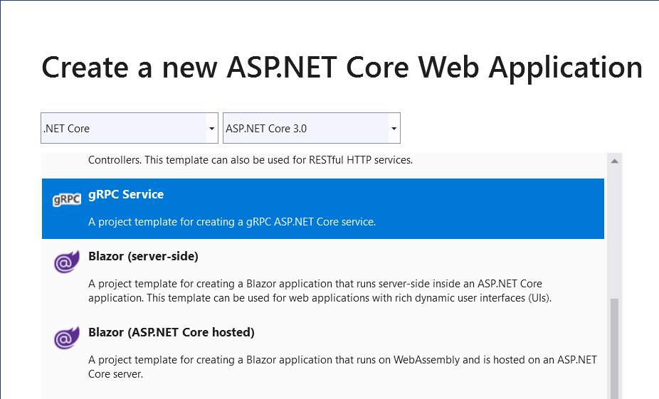
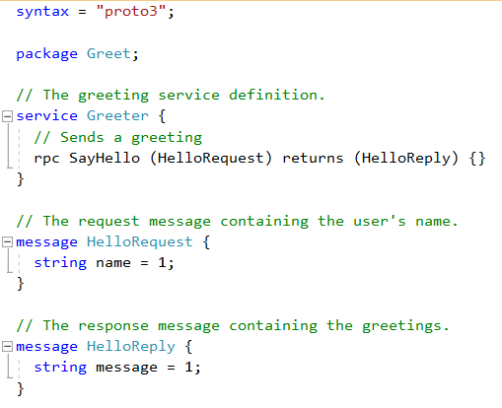
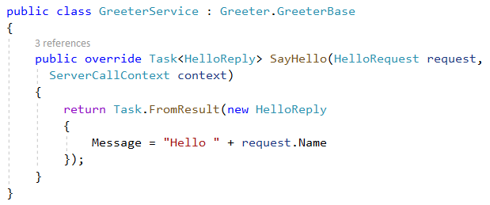
gRPC
High performance, contract-based RPC services
Broad interoperability for polyglot environments
Great for service-to-service communication
Notes:
gRPC (gRPC Remote Procedure Calls¹​) es un sistema de llamada a procedimiento remoto (RPC) de código abierto desarrollado inicialmente en Google. Utiliza como transporte HTTP/2 y Protocol Buffers como lenguaje de descripción de interfaz. Proporciona características como autenticación, transmisión bidireccional y control de flujo, enlaces bloqueantes o no bloqueantes, cancelaciones y tiempos de espera. Genera enlaces multiplataforma entre cliente y servidor para muchos lenguajes. Entre los caso de uso más comunes, incluye la conexión de servicios en la arquitectura microservicios y la conexión de dispositivos móviles, navegador clientes a los servicios backend.

Slide 14
gRPC in ASP.NET Core 3.x
New gRPC Service template
Generate gRPC client code

Slide 15



Updated SPA templates
Angular 8
React 16
Authentication support with IdentityServer
Angular
React
React+Redux

Slide 16
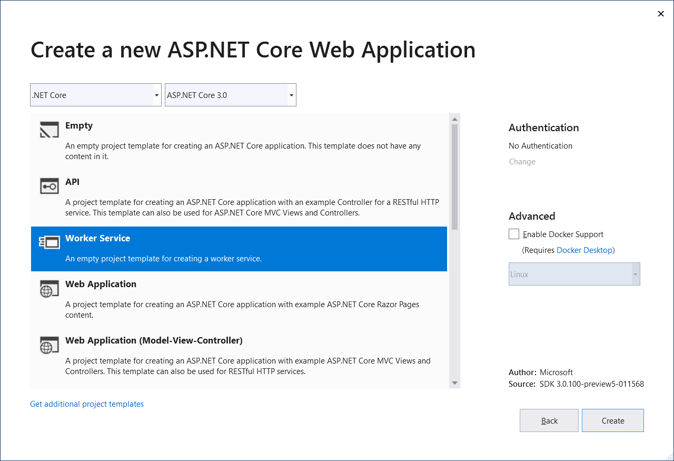
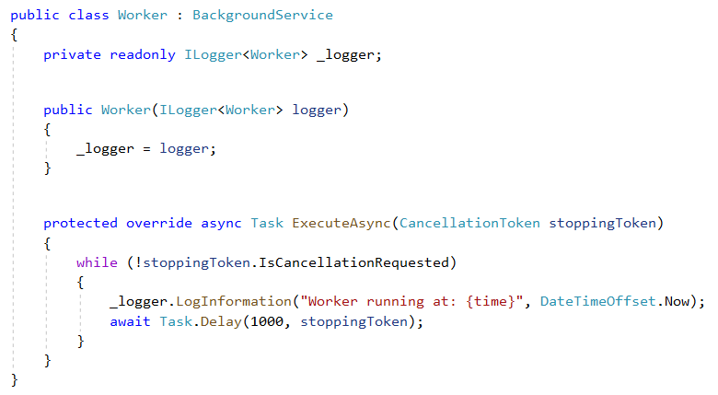
Worker services
New Worker Service template
Build long-running worker processes
May or may not have endpoints
Host in Windows services, systemd
Integrates with configuration, logging, dependency injection
Notes:
En primer lugar, tenemos una nueva plantilla disponible para esto: Worker Service. Usando esta plantilla, vamos a poder tener un ejemplo para construir nuestro servicio.
La principal novedad al crear nuestras tareas dentro del servicio, es que ahora heredamos de la clase abstracta «BackgroundService» (y no de IHostedService como hacíamos en .Net Core 2.X).

Slide 17
New SignalR features
Client-to-server streaming
Auto-reconnect
C# 8 & IAsyncEnumerable support

Slide 18
New ASP.NET Core features in .NET Core 3.0
Blazor
gRPC
Worker services
OpenAPI client code generation
HTTP REPL
Endpoint routing integration
C# 8 in Razor & MVC
System.Text.Json integration
SignalR auto-reconnect, streaming
Angular 8, React 16
SPA authentication
Certificate & Kerberos authentication
HTTP/2 by default
Generic host in templates
Event counters
https://docs.microsoft.com/aspnet/core/release-notes/aspnetcore-3.0
Notes:
signalr websocket

Slide 19
RELEASED
.NET Core 3.1
Long-Term Support (LTS)
Bug fixes and stability improvements
https://dotnet.microsoft.com/download/dotnet-core/3.1

Slide 20
New ASP.NET Core features in .NET Core 3.1
Component partial classes
Pass parameters to top-level components
Prevent default event actions in Blazor apps
Stop event propagation in Blazor apps
Component tag helper
Detailed errors during Blazor app development
Support for shared queues in HttpSysServer

Slide 21
.NET Schedule
May 2020
Blazor WebAssembly!
July 2019
.NET Core 3.0
RC
Sept 2019
.NET Core 3.0
Nov 2019
.NET Core 3.1
LTS
Nov 2020
.NET 5.0
Nov 2021
.NET 6.0
LTS
Nov 2022
.NET 7.0
Nov 2023
.NET 8.0
LTS
.NET Core 3.0 released at .NET Conf in September
.NET Core 3.1 = Long Term Support (LTS)
.NET 5.0 release in November 2020
Major releases every year, LTS for even numbered releases
Predictable schedule, minor releases if needed

Slide 22
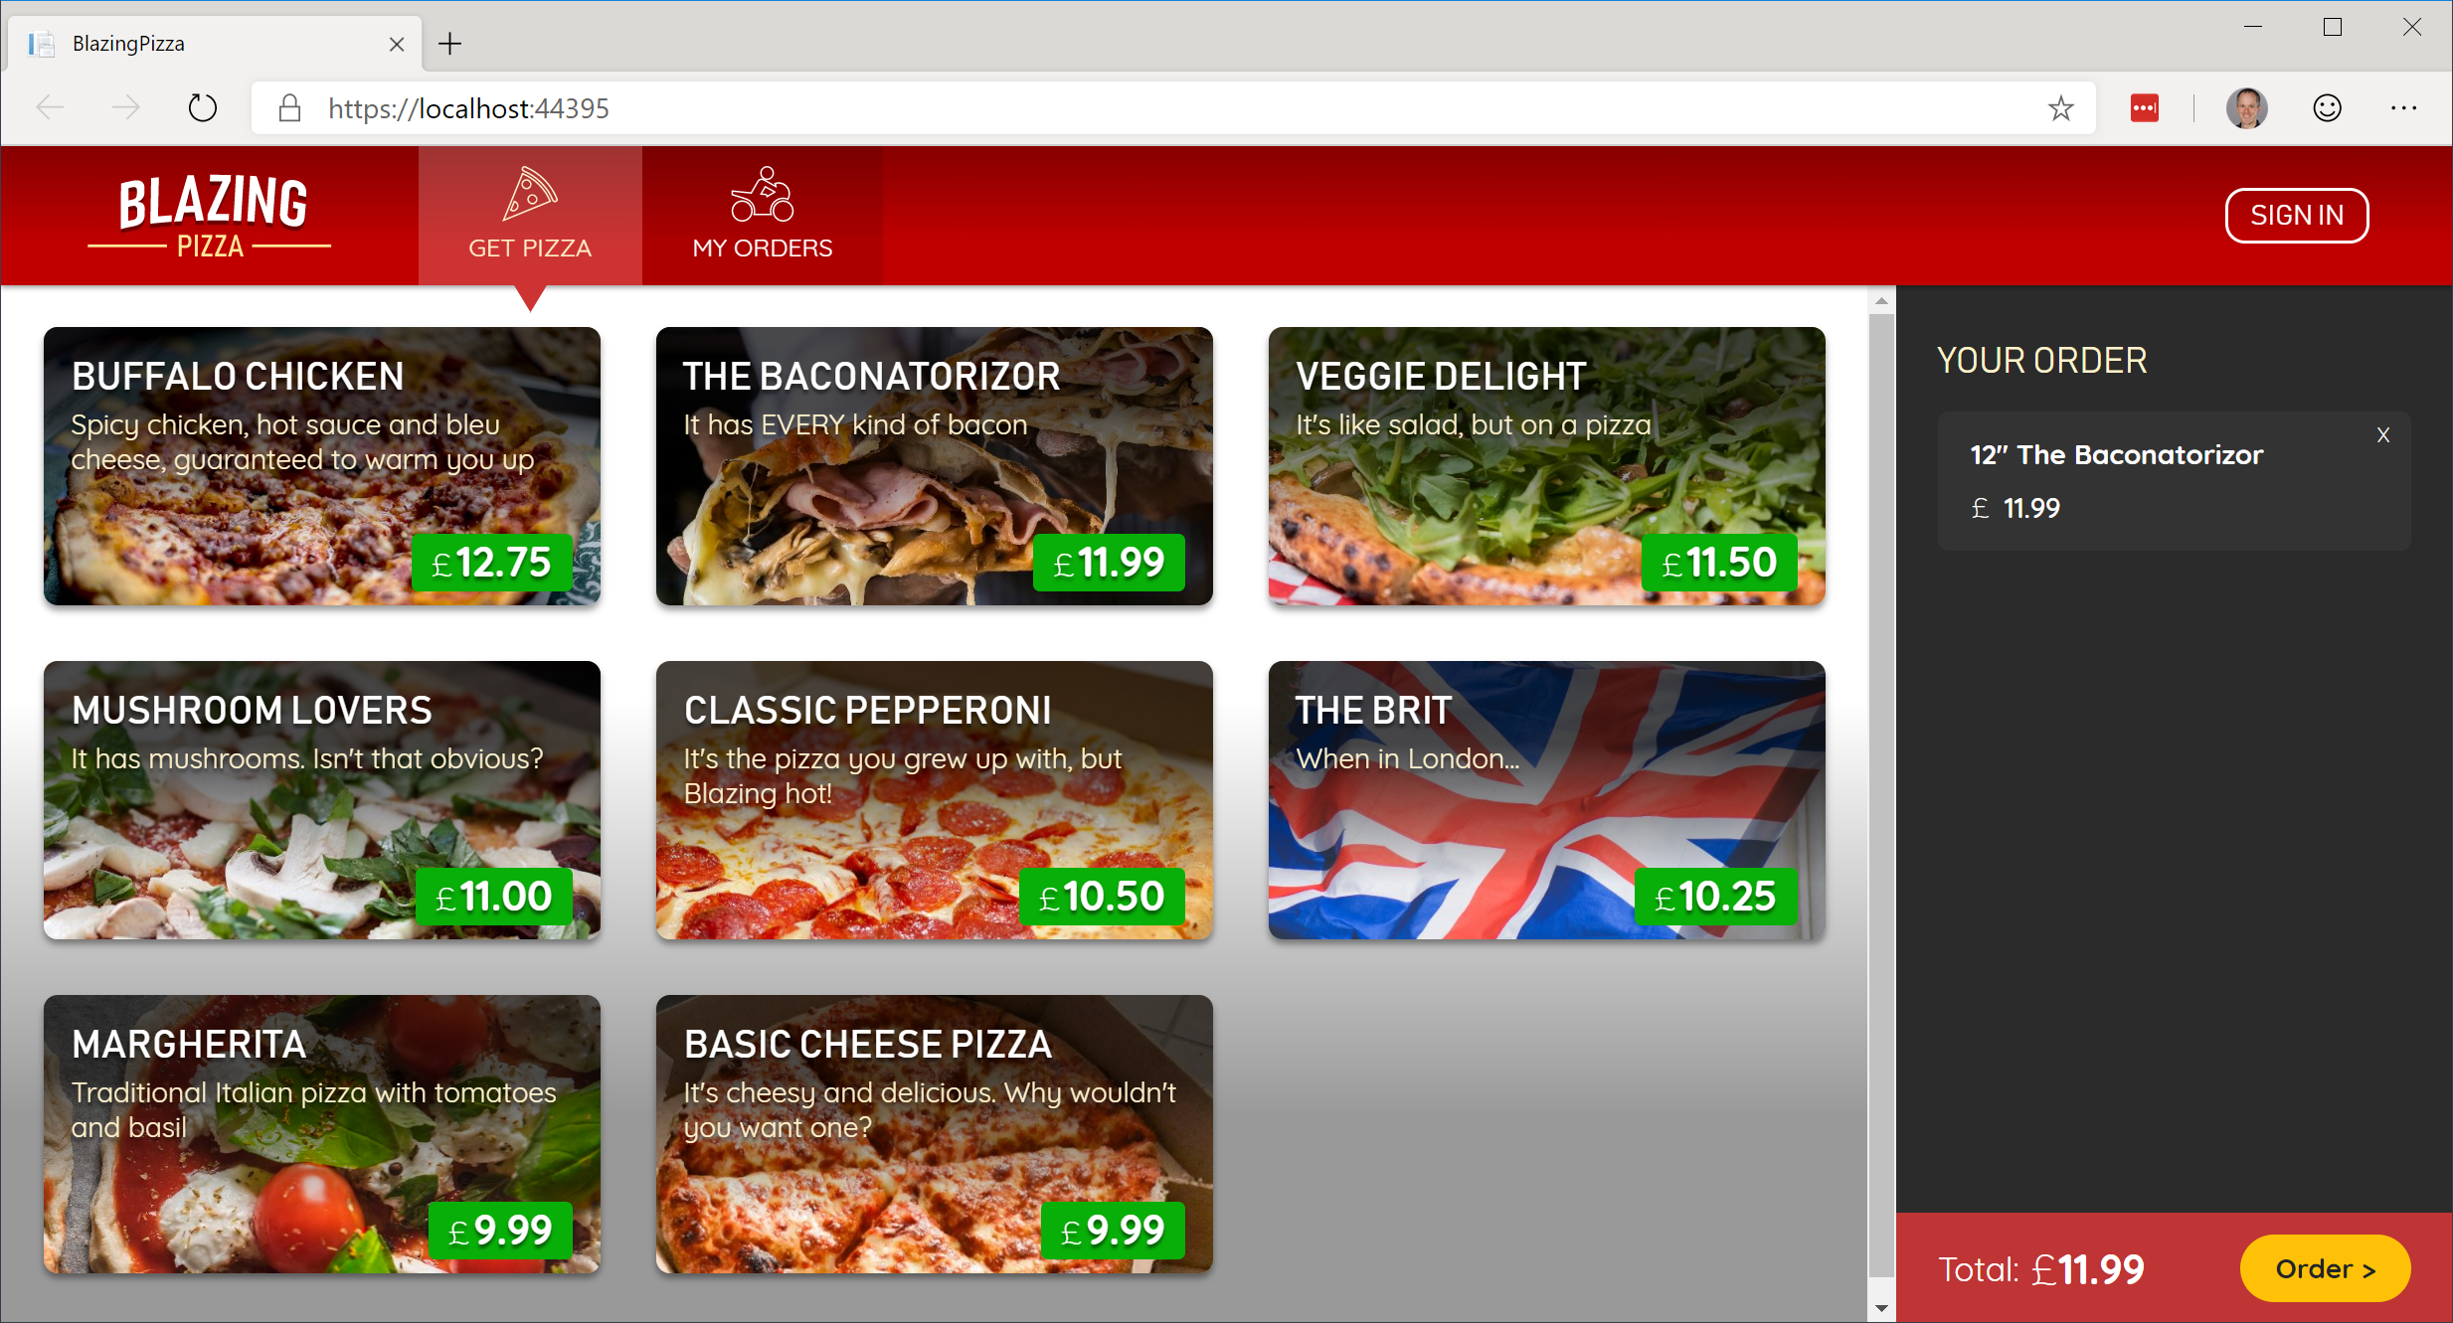
Build your own pizza store UI with Blazor
https://aka.ms/blazorworkshop

Slide 23
Try .NET Core 3.x with ASP.NET Core today!
Download: https://dot.net/get-core3
Visual Studio: https://visualstudio.com/
Docs: https://docs.asp.net
Blazor: https://blazor.net
Workshop: https://aka.ms/blazorworkshop

